Slide 1
My Hobby

Slide 2
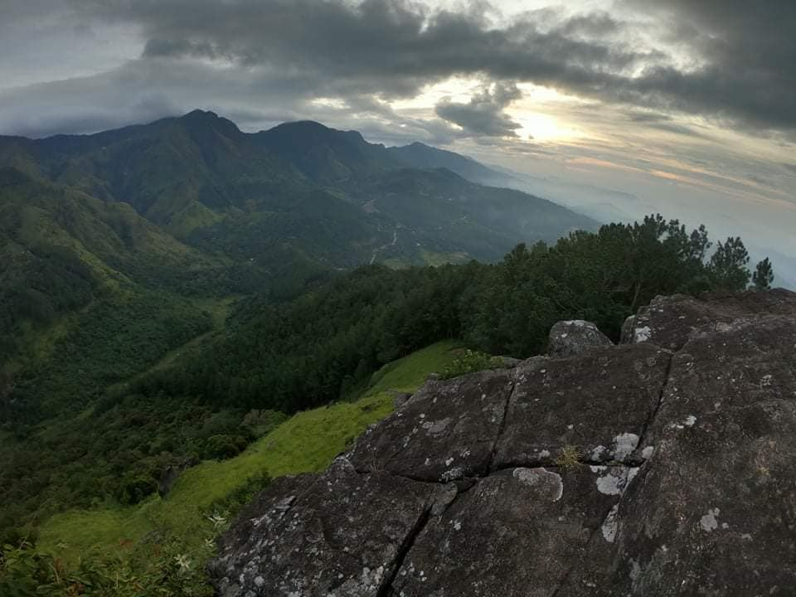
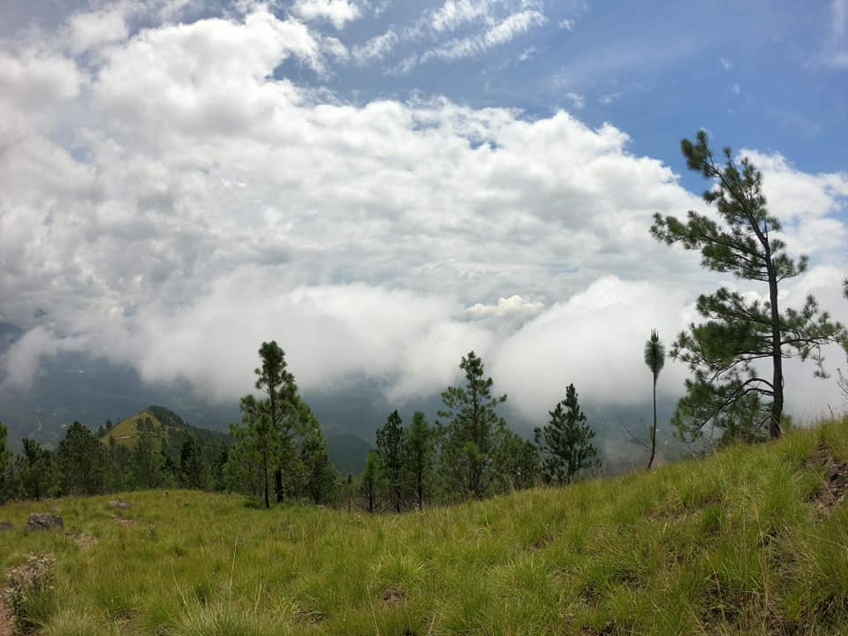

Slide 3
Why travelling??????

Slide 4
The places I have travelled so far .....
Manigala Mountain
Kirigalpoththa Mountain
Wangedigala Mountain
Dhanigala
Panama
Blue Beach Island

Slide 5
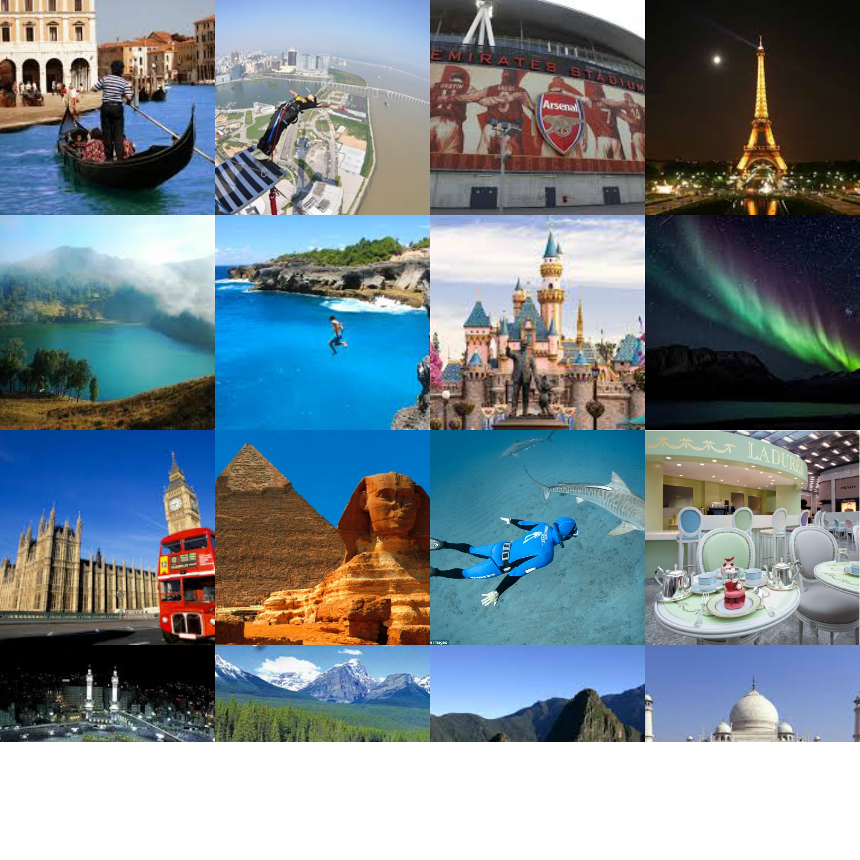
Next ....

Slide 6
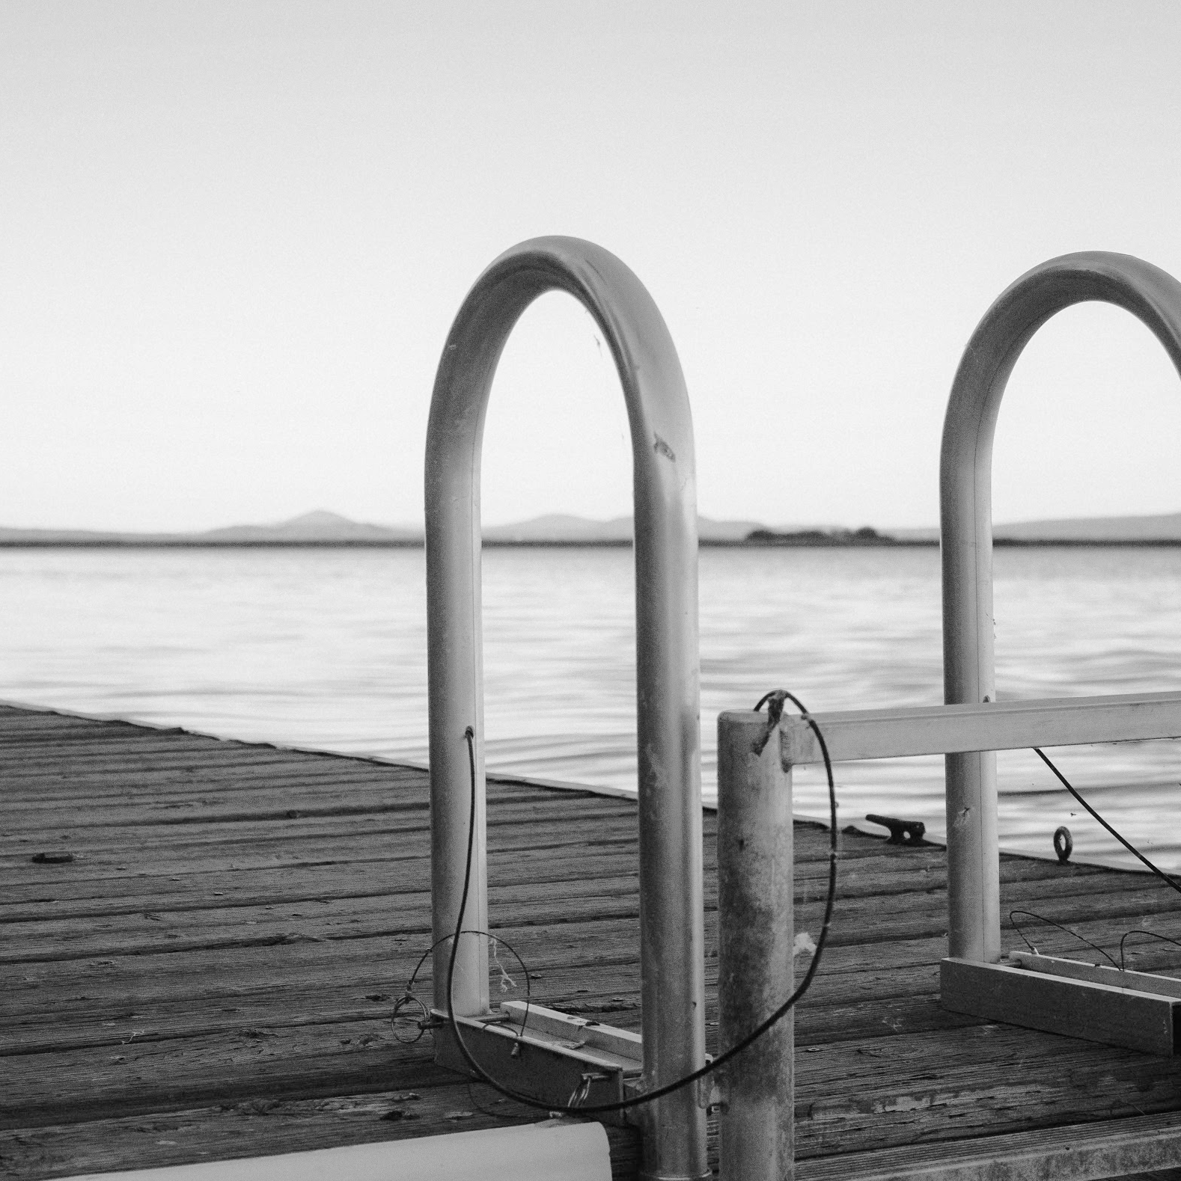
“Traveling – it leaves you speechless, then turns you into a storyteller.” – Ibn Battuta

Slide 7
Thank You

